Slide 1
Operation DAD
Ben Dunbar, Justin Hynes-Bruell, and Bill Wisheart

Slide 2
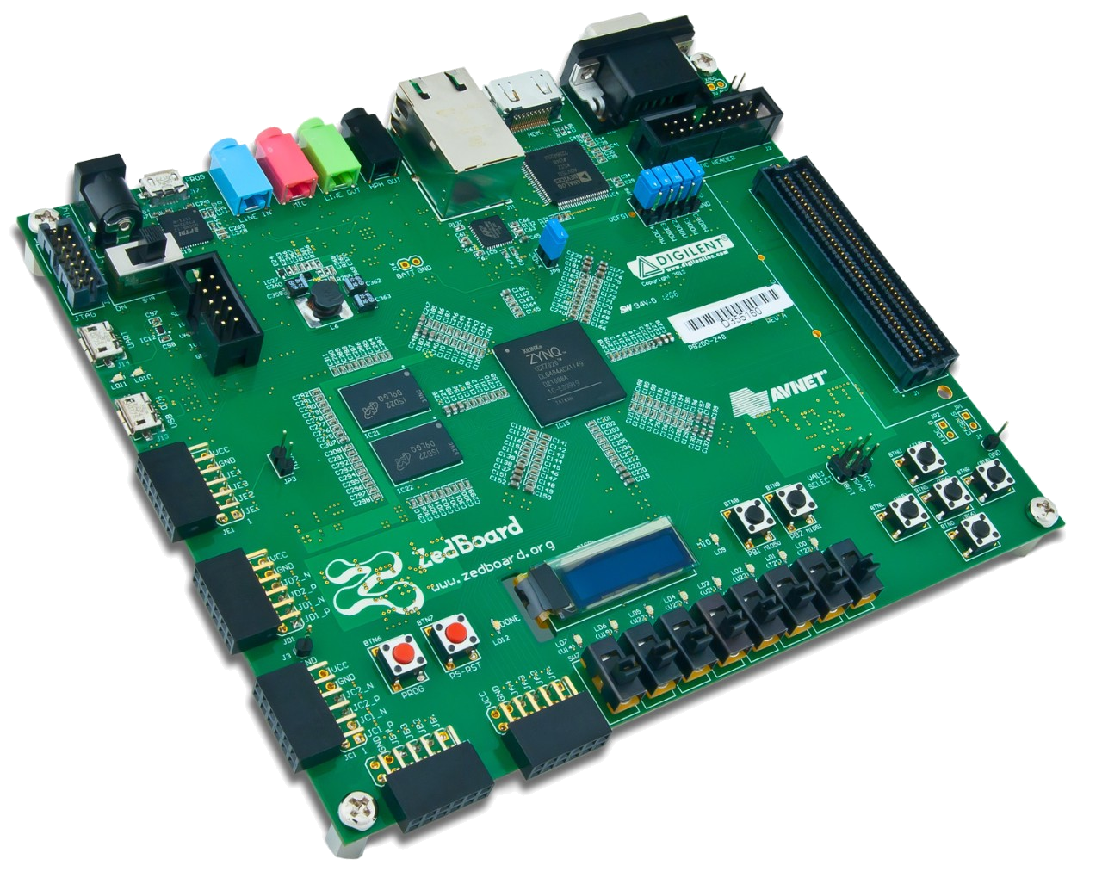
Outline
Introduction
Solution Approach
Inputs/Outputs
Conceptual Understanding
Experimental Results
Conclusion

Slide 3
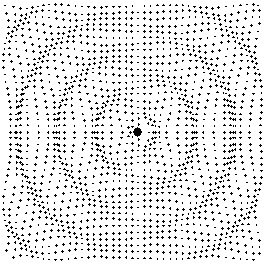
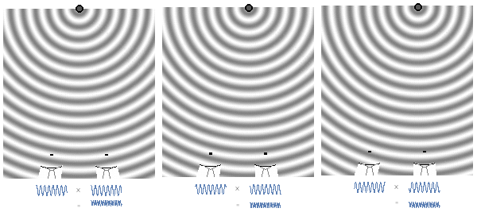
Introduction to Direction Audio Detection (DAD)
Real time system that utilizes 2 microphones mounted on a wall to analyze sound waves and determine in which direction the sound originated from
Goal: Learn how to handle and compare two audio inputs while implementing skills gained from previous labs
Application: A security camera with a limited field of view could turn towards a source of sound

Slide 4
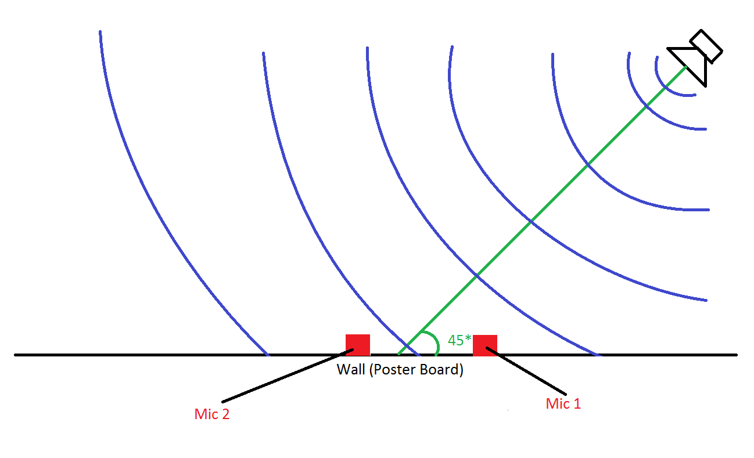
Solution Approach - Inputs
Fixed distance apart
32.7279 mm

Slide 5
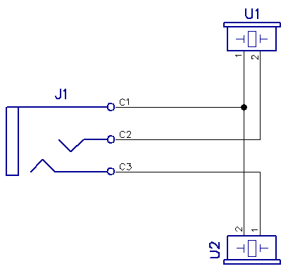
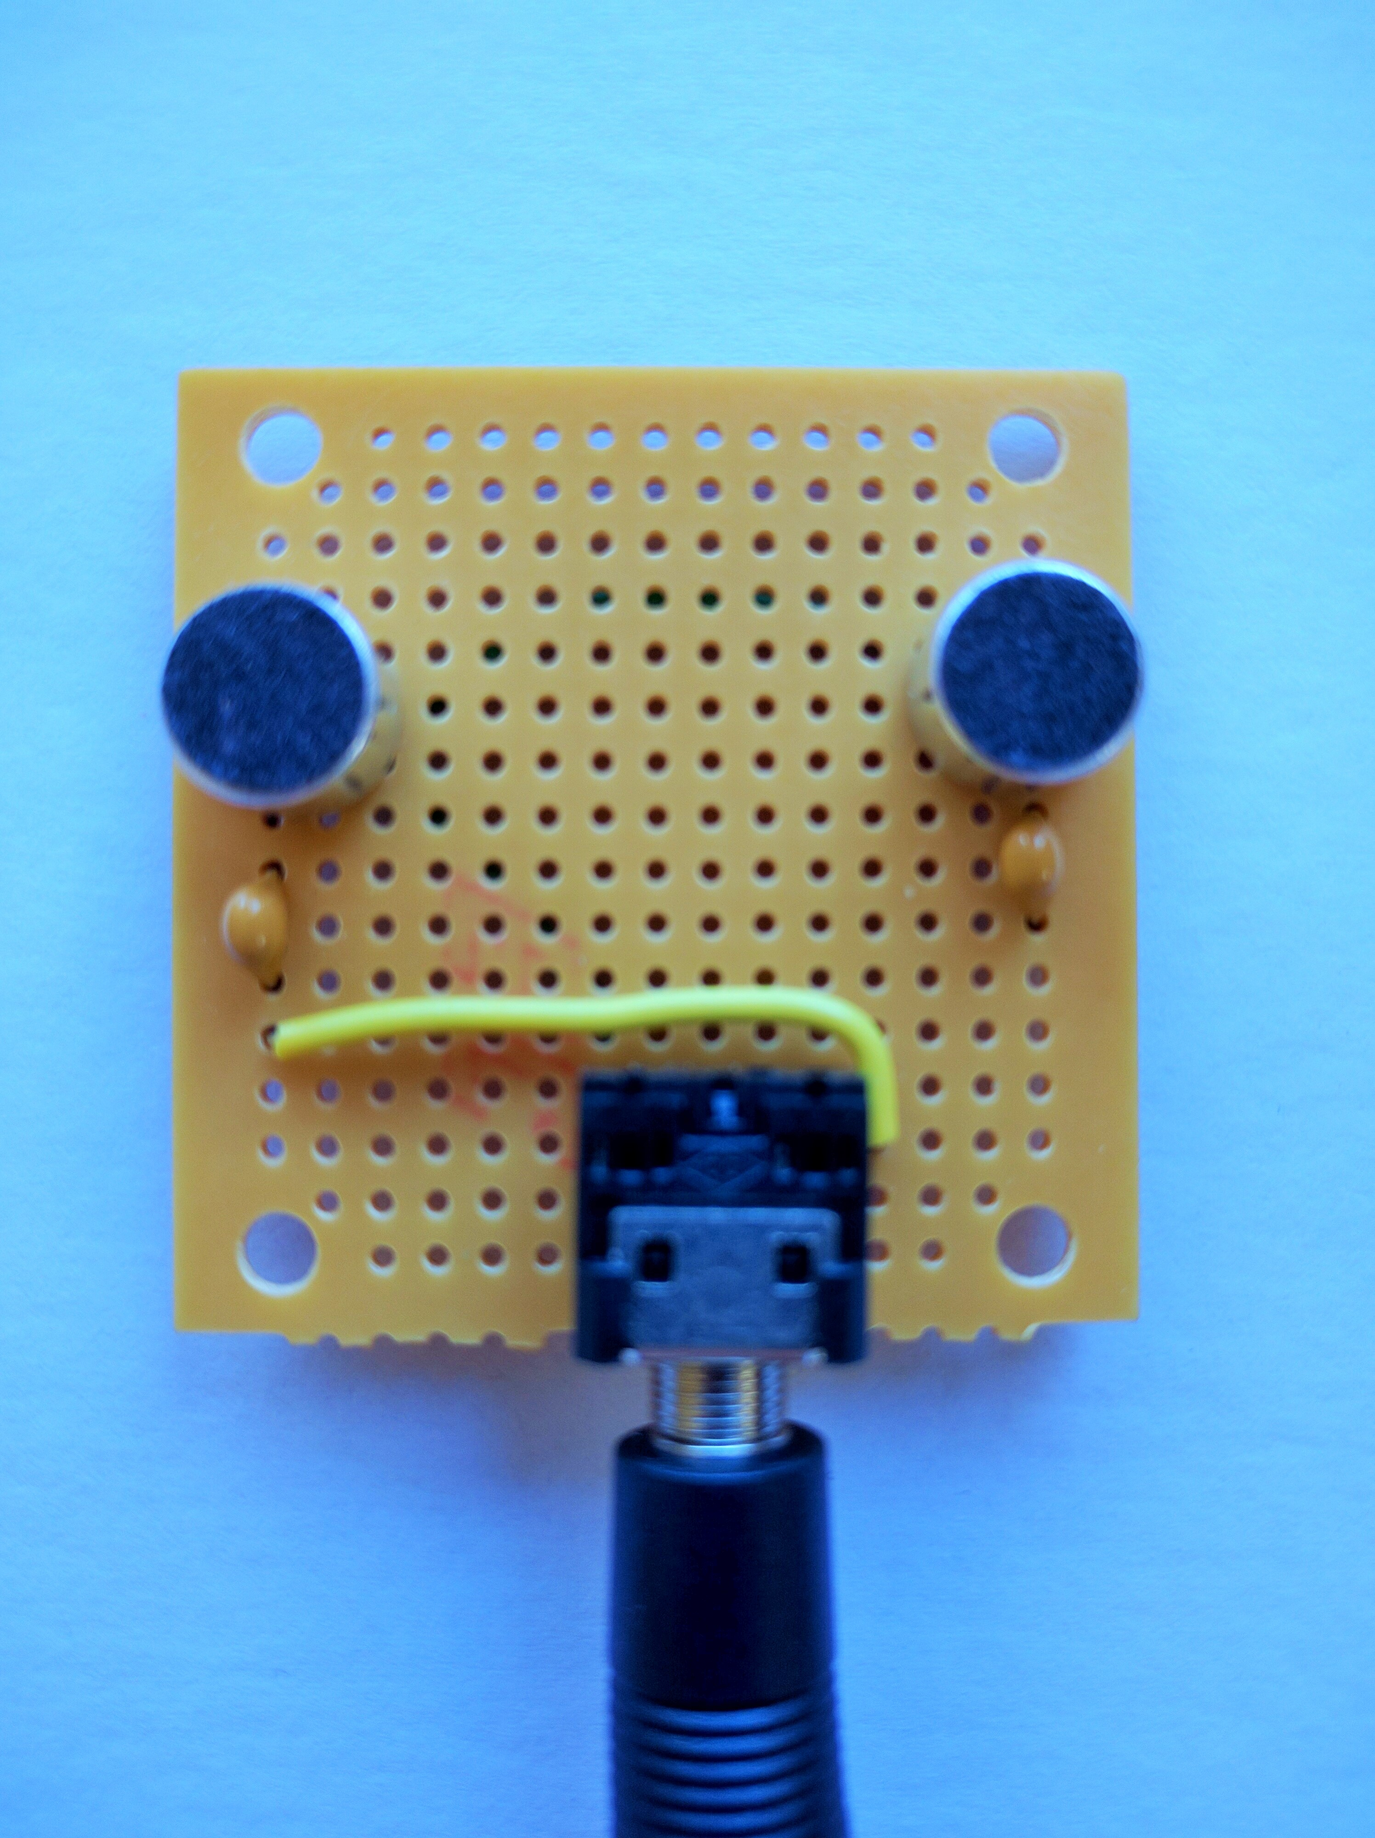
Hardware
Schematic
Microphone Platform

Slide 6
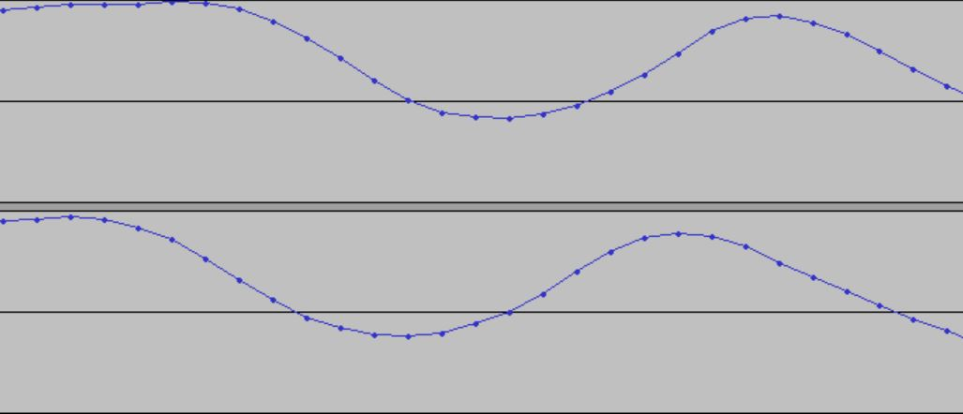
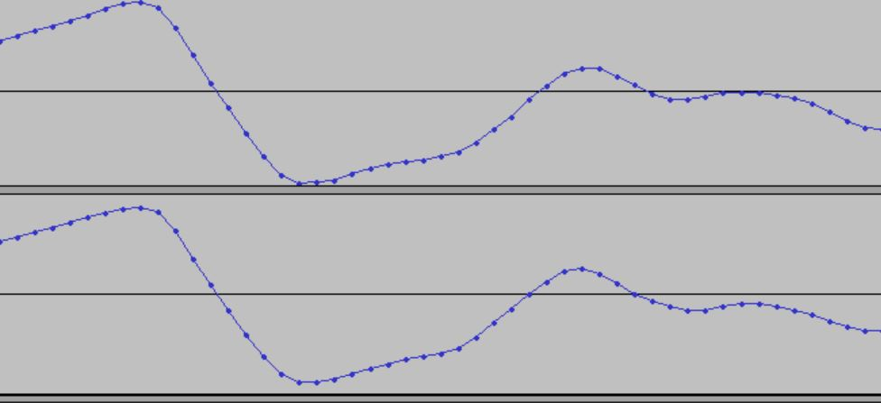
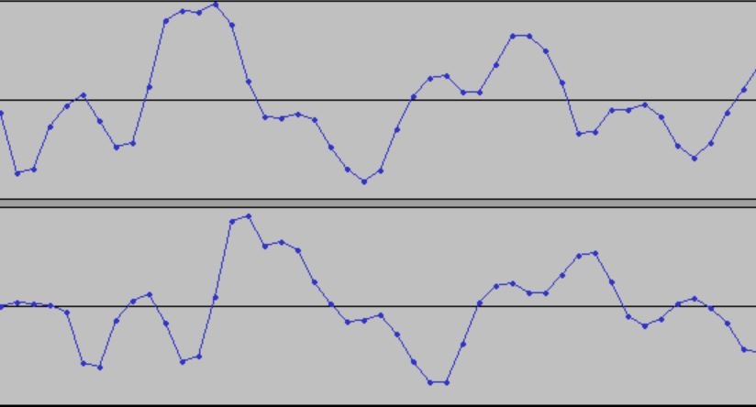
Simulation/Sampling – Audacity
Right
Right Sound
Left
Right
Center Sound
Left
Right
Left Sound
Left

Slide 7
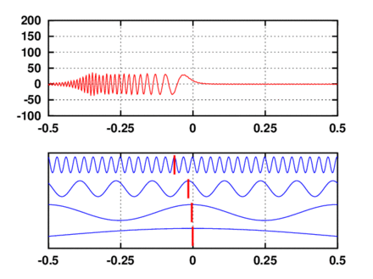
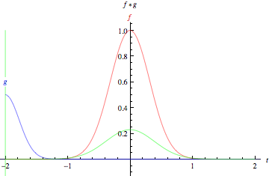
Processing Cross-Correlation of Data
Gather Signal1 and Signal 2 in arrays of size n
Convolve the two arrays together to create a array “X” of size n+n
Search for Global Max in “X” and determine position it is at.
The distance the Global Max is from the center is the Phase Shift of the Signal

Slide 8
MATLAB Simulation

Slide 9
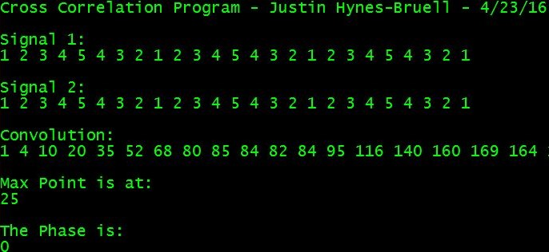
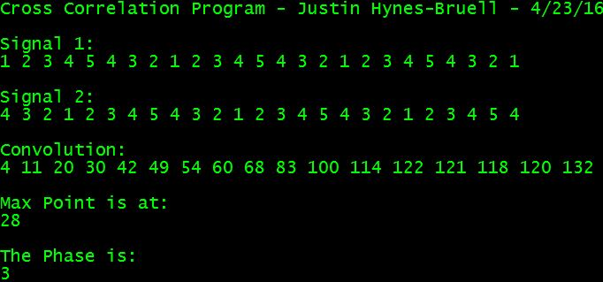
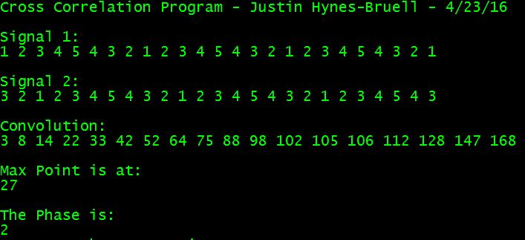
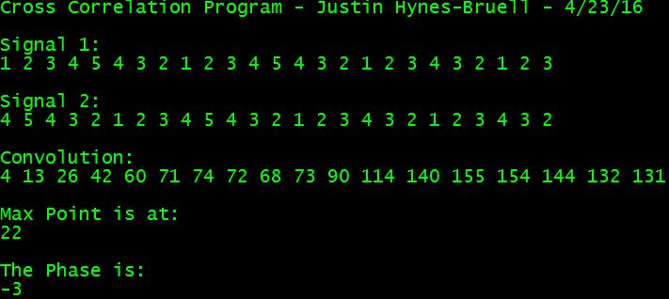
C++ Simulation

Slide 10
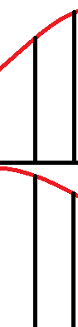
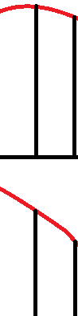
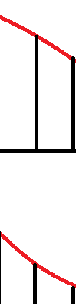

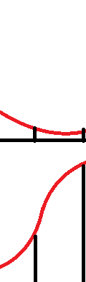

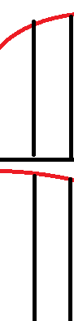
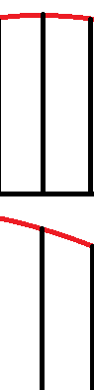
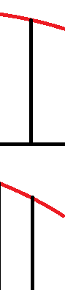
Processing RX DATA

Slide 11
Solution Approach – angle computation
//Get the phase difference from the convolve queue.
int samplesDelayed = convolveQueue_getSampleCountPhaseDiff(&pThis->convQueue);
//Angle equation:
//Our calculations will work when the two signals are between -4 and 4 samples
//different in terms of phase offset.
double ratio = (double) SPEED_SOUND * (samplesDelayed/SAMPLING_FREQUENCY)/MIC_DISTANCE;
double sourceAngle = asin(ratio);
//source angle to degrees
sourceAngle = sourceAngle * 180.0/PI;
//This calculated angle is the angle away from the line that is equidistant from each
//microphone, which is 90 degrees in our analysis.
int angle = 90 + (int) sourceAngle;
//Give tenths of degrees
angle = angle * 10;

Slide 12
Solution approach - Outputs
This slide will go over how the Angle and Distance output was passed to the output task and displayed.

Slide 13
Experimental Results
Gathered test files from the mic setup.
Analyzed test files in MatLab to determine viablilty of convolution approach.
Output completed, tested once the new workspace was available.
Processing was tested to make sure that given the phase difference, the angle calculation was correct.
In the end the mics could pick up audio, the processor could analyze the signal, and the LEDs and OLED screen could successfully return the calculated result.

Slide 14
Conclusion
Difficulties faced
Tasks ended up blocking each other during debug periods
Successfully gathering left and right data from the RX chunks
Understanding correlations using the convolve method
Solutions created
Raised the priority of the output task and ensured it would go into the suspend state so the processing task could run.
Gathered left samples with a 24 bit shift on the pChunk->u16_buff
Gathered right samples with a 16 bit shift and then a 0x00FF mask on the data.
Placed samples into separate arrays
Wrote a function to perform a convolution on two arrays of unsigned int to determine the phase shift between the two arrays

Slide 15
Bibliography
Image of ZedBoard
http://www.xilinx.com/content/xilinx/en/support/university/boards-portfolio/xup-boards/XUPZedBoard/_jcr_content/mainParsys/xilinxcolumns_f62b/column0/xilinxbuybox_943e/thumbnail/image.img.jpg/1381869368208.jpg
Sound Waves
https://nbickford.wordpress.com/2015/05/03/interferometry-and-the-very-large-array/

